Slide 1
KNN
Marlabs

Slide 2
KNN
K-Nearest Neighbors
KNN can be used for both classification and regression predictive problems. However, it is more widely used in classification problems in the industry.

Slide 3
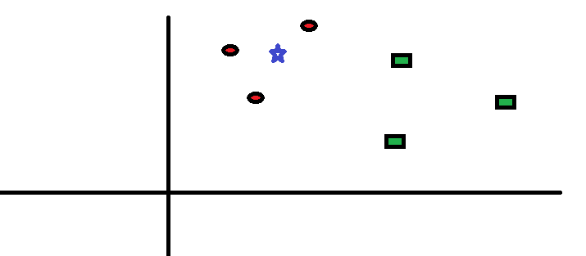
How does the KNN algorithm work?
A spread of red circles (RC) and green squares (GS) :
The goal is to find out the class of the blue star (BS) . BS can either be RC or GS and nothing else.

Slide 4
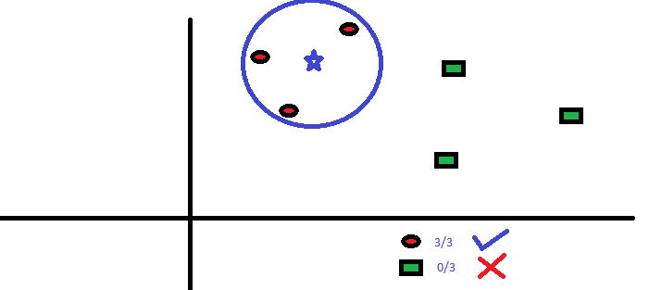
The “K” in KNN algorithm is the nearest neighbors we wish to take vote from.
You intend to find out the class of the blue star (BS) . BS can either be RC or GS and nothing else. The “K” in KNN algorithm is the nearest neighbors we wish to take vote from.

Slide 5
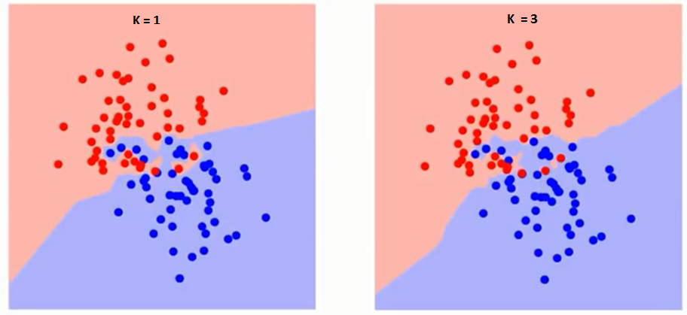
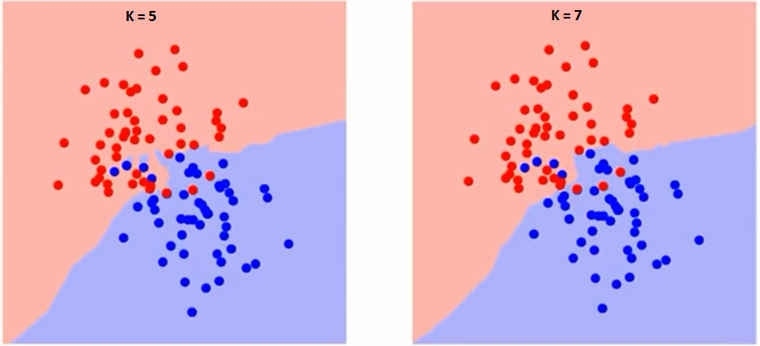
How do we choose the factor K?
The boundary becomes smoother with increasing value of K.
With K increasing to infinity it finally becomes all blue or all red depending on the total majority.

Slide 6
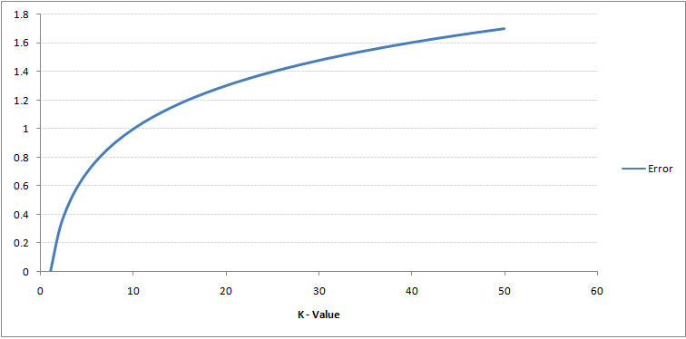
Training Error Rate & Validation Error Rate
The training error rate and the validation error rate are two parameters we need to access on different K-value.
The right is the curve for the training error rate with varying value of K.
The error rate at K=1 is always zero for the training sample. This is because the closest point to any training data point is itself.
Hence the prediction is always accurate with K=1. If validation error curve would have been similar, our choice of K would have been 1.

Slide 7
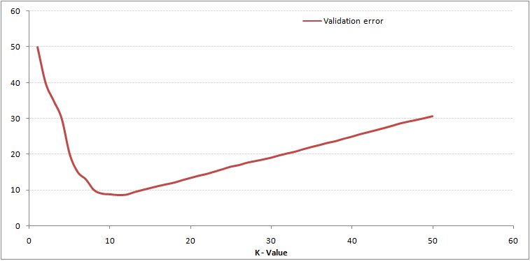
Training Error Rate & Validation Error Rate
The right plot is validation error curve with varying value of K.
At K=1, we were overfitting the boundaries. Hence, error rate initially decreases and reaches a minima. After the minima point, it then increase with increasing K.
To get the optimal value of K, you can segregate the training and validation from the initial dataset. Now plot the validation error curve to get the optimal value of K. This value of K should be used for all predictions.

Slide 8
KNN Algorithm Steps
Choose the number of k and a distance metric. For distance metric, you may use Euclidean distance, Chebyshev, cosine, etc.
Find the k-nearest neighbors of the sample that we want to classify.
Assign the class label by majority vote.

Slide 9
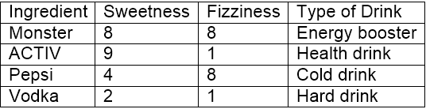
Example:
10 ‘drinking items’ which are rated on two features on a scale of 1 to 10.
The two features are “sweetness” and “fizziness”.
“Sweetness” determines the perception of the sugar content in the items.
“Fizziness” ascertains the presence of bubbles in the drink due to the carbon dioxide content in the drink.

Slide 10
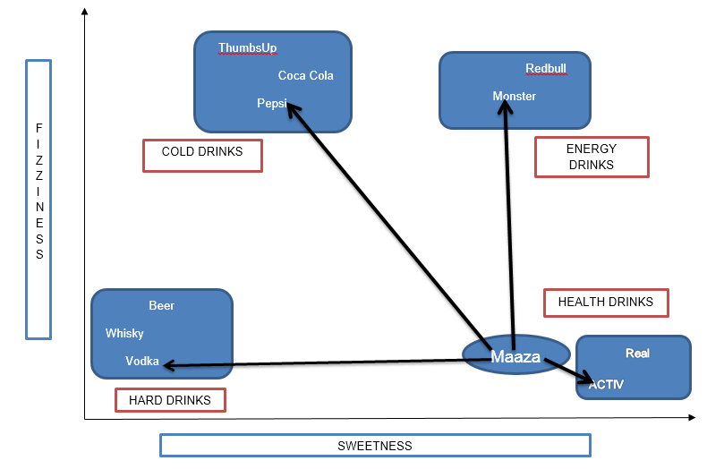
It is clear we have bucketed the 10 items into 4 groups namely, ’COLD DRINKS’, ‘ENERGY DRINKS’, ‘HEALTH DRINKS’ and ‘HARD DRINKS’.

Slide 11
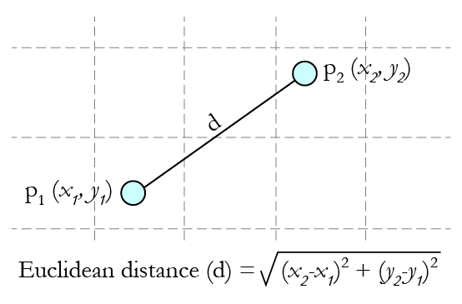
Calculating Distance
Which group would ‘Maaza’ fall into? This will be determined by distance.
The most popular distance matric is Euclidean distance formula: the shortest distance between the 2 points.

Slide 12
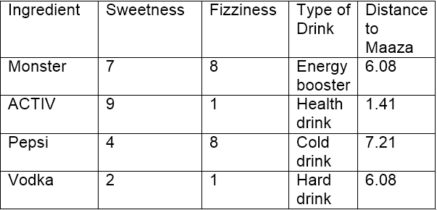
Using the co-ordinates of Maaza (8,2) and Vodka (2,1), the distance between ‘Maaza’ and ‘Vodka’ can be calculated as: dist(Maaza,Vodka) = 6.08
Using Euclidean distance, we can calculate the distance of Maaza from each of its nearest neighbors. Distance between Maaza and ACTIV being the least, it may be inferred that Maaza is same as ACTIV in nature which in turn belongs to the group of drinks (Health Drinks).
If k=1, the algorithm considers the nearest neighbor to Maaza i.e, ACTIV;
If k=3, the algorithm considers ‘3’ nearest neighbors to Maaza to compare the distances (ACTIV, Vodka, Monster) – ACTIV stands the nearest to Maaza.

Slide 13
KNN Algorithm – Pros and Cons
Pros: The algorithm is highly unbiased in nature and makes no prior assumption of the underlying data. Being simple and effective in nature, it is easy to implement and has gained good popularity.
Cons:
The training process is really fast as the data is stored verbatim (hence lazy learner) ,but the prediction time is pretty high with useful insights missing at times. Therefore, building this algorithm requires time to be invested in data preparation (especially treating the missing data and categorical features) to obtain a robust model.

